Slide 1


Onur TEKEREKOĞLU
28.01.2023

Slide 2

Outline
Executive Summary
Introduction
Methodology
Results
Conclusion
Appendix

Slide 3
Executive Summary
Methodologies
Data Collection with API
Data Collection with Web Scraping
Data Wrangling
EDA With Data Visualization
EDA as Visual Analytics With Folium
Machine Learning Predictions
Results
EDA
Predictive Analytics Result

Slide 4
Introduction
Project background and context
For evaluating Space Y, Space X is examined in detail.
Problems you want to find answers
Which ways are the best cost for launches?
Where is the best place to make launches?
What operating situations do need to be placed to unsure a successful landing program

Slide 5

Section 1

Slide 6
Methodology
Executive Summary
Data collection methodology:
Taking Url as JSON TYPE. Then it is changed type it from Json to Data Frame
Perform data wrangling
Null boxes in Data Frame is changed with mean of that column.
Perform exploratory data analysis (EDA) using visualization and SQL
Perform interactive visual analytics using Folium and Plotly Dash
Perform predictive analysis using classification models
How to build, tune, evaluate classification models

Slide 7
Data Collection
How data sets were collected.?
Get request to SpaceX API
Json() Funtion
Json_normalize()
isnull(), Dropna(),fillna()
BeautifulSoup()
Html table

Slide 8
Data Collection – SpaceX API
https://github.com/OnurTekerekoglu/IBM_DataScience_Project/blob/main/Data_Collection.ipynb
Request API
Filter Data
Cope with Missing Values

Slide 9
Data Collection - Scraping
https://github.com/OnurTekerekoglu/IBM_DataScience_Project/blob/main/Data_Wrangling.ipynb
Request Falcon 9 From Wiki
Extraxt Values from HTML Table Header
Create Data Frame

Slide 10
Data Wrangling
https://github.com/OnurTekerekoglu/IBM_DataScience_Project/blob/main/Data_Wrangling.ipynb
EDA
Summarizations
Creating Landing Outcome Label

Slide 11
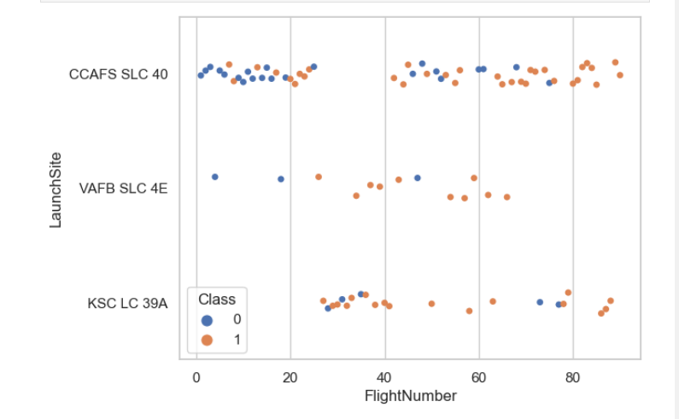
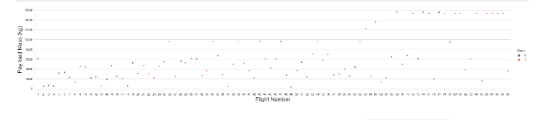
EDA with Data Visualization
https://github.com/OnurTekerekoglu/IBM_DataScience_Project/blob/main/Data_EDA_Viz.ipynb

Slide 12
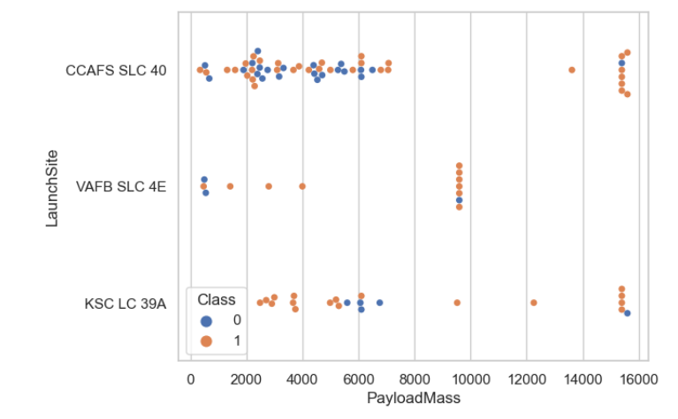
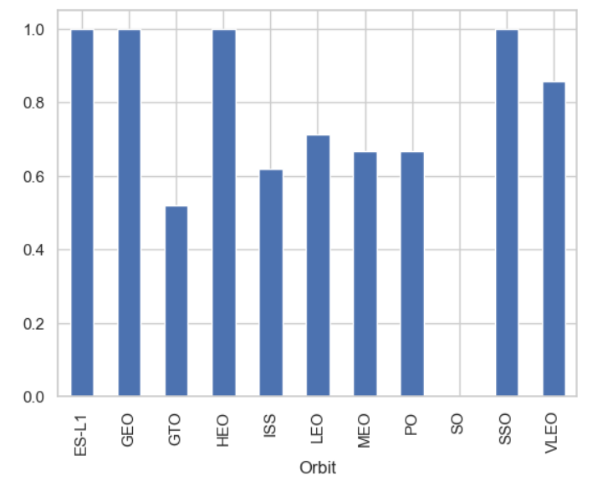

Slide 13
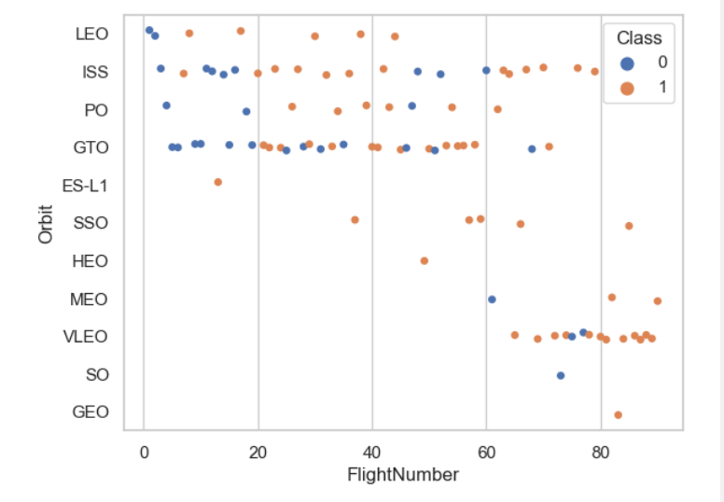
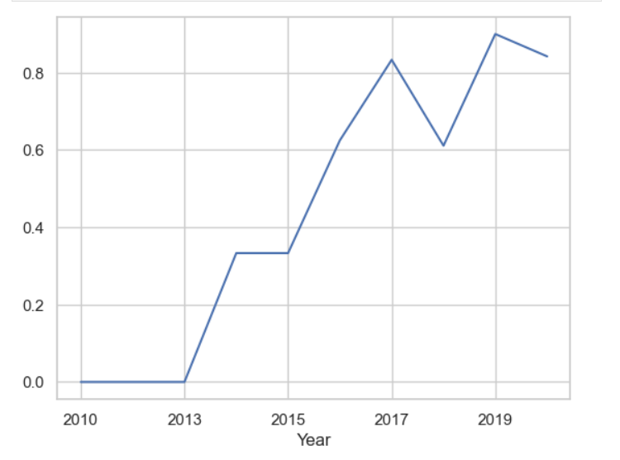

Slide 14
EDA with SQL
Using bullet point format, summarize the SQL queries you performed
Add the GitHub URL of your completed EDA with SQL notebook, as an external reference and peer-review purpose

Slide 15
Build an Interactive Map with Folium
https://github.com/OnurTekerekoglu/IBM_DataScience_Project/blob/main/EDA_With_Folium.ipynb
All launch sites are marked, and added map objects such as markers, circles, lines to mark the success or failure of launches for each site on the folium map.
The feature launch outcomes (failure or success)are assigned to class 0 and 1.i.e., 0 for failure, and 1 for success.
Using the color-labeled marker clusters, relatively high success rate launhces are marked.

Slide 16
Predictive Analysis (Classification)
https://github.com/OnurTekerekoglu/IBM_DataScience_Project/blob/main/Machine%20Learning%20Prediction.ipynb
Data using numpy and pandas are loaded, transformed.
Data are splited into training and testing.
Various machine learning models and tune different hyperparameters are applied by using GridSearchCV.
Accuracy as the metric for model is used, and improved by using feature engineering and algorithm tuning.
Best-performing classification model is selected.

Slide 17

Section 2

Slide 18

Flight Number vs. Launch Site

Slide 19

Payload vs. Launch Site

Slide 20

Success Rate vs. Orbit Type

Slide 21

Flight Number vs. Orbit Type

Slide 22

Payload vs. Orbit Type

Slide 23

Launch Success Yearly Trend

Slide 24
All Launch Site Names
Find the names of the unique launch sites
Present your query result with a short explanation here

Slide 25
Launch Site Names Begin with 'CCA'
Find 5 records where launch sites begin with `CCA`
Present your query result with a short explanation here

Slide 26
Total Payload Mass
Calculate the total payload carried by boosters from NASA
Present your query result with a short explanation here

Slide 27
Average Payload Mass by F9 v1.1
Calculate the average payload mass carried by booster version F9 v1.1
Present your query result with a short explanation here

Slide 28
First Successful Ground Landing Date
Find the dates of the first successful landing outcome on ground pad
Present your query result with a short explanation here

Slide 29
Successful Drone Ship Landing with Payload between 4000 and 6000
List the names of boosters which have successfully landed on drone ship and had payload mass greater than 4000 but less than 6000
Present your query result with a short explanation here

Slide 30
Total Number of Successful and Failure Mission Outcomes
Calculate the total number of successful and failure mission outcomes
Present your query result with a short explanation here

Slide 31
Boosters Carried Maximum Payload
List the names of the booster which have carried the maximum payload mass
Present your query result with a short explanation here

Slide 32
2015 Launch Records
List the failed landing_outcomes in drone ship, their booster versions, and launch site names for in year 2015
Present your query result with a short explanation here

Slide 33
Rank Landing Outcomes Between 2010-06-04 and 2017-03-20
Rank the count of landing outcomes (such as Failure (drone ship) or Success (ground pad)) between the date 2010-06-04 and 2017-03-20, in descending order
Present your query result with a short explanation here

Slide 34

Section 3

Slide 35

<Folium Map Screenshot 1>

Slide 36

<Folium Map Screenshot 2>

Slide 37

<Folium Map Screenshot 3>
Replace <Folium map screenshot 3> title with an appropriate title
Explore the generated folium map and show the screenshot of a selected launch site to its proximities such as railway, highway, coastline, with distance calculated and displayed
Explain the important elements and findings on the screenshot

Slide 38

Section 4

Slide 39
<Dashboard Screenshot 1>
Replace <Dashboard screenshot 1> title with an appropriate title
Show the screenshot of launch success count for all sites, in a piechart
Explain the important elements and findings on the screenshot

Slide 40
<Dashboard Screenshot 2>
Replace <Dashboard screenshot 2> title with an appropriate title
Show the screenshot of the piechart for the launch site with highest launch success ratio
Explain the important elements and findings on the screenshot

Slide 41
<Dashboard Screenshot 3>
Replace <Dashboard screenshot 3> title with an appropriate title
Show screenshots of Payload vs. Launch Outcome scatter plot for all sites, with different payload selected in the range slider
Explain the important elements and findings on the screenshot, such as which payload range or booster version have the largest success rate, etc.

Slide 42

Section 5

Slide 43
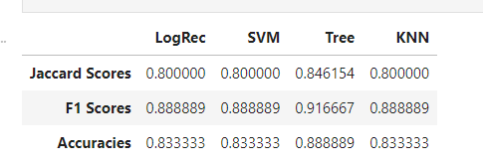
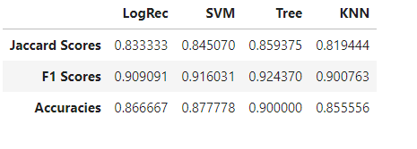
Classification Accuracy
For Test Data Sets
For Whole Data Sets

Slide 44
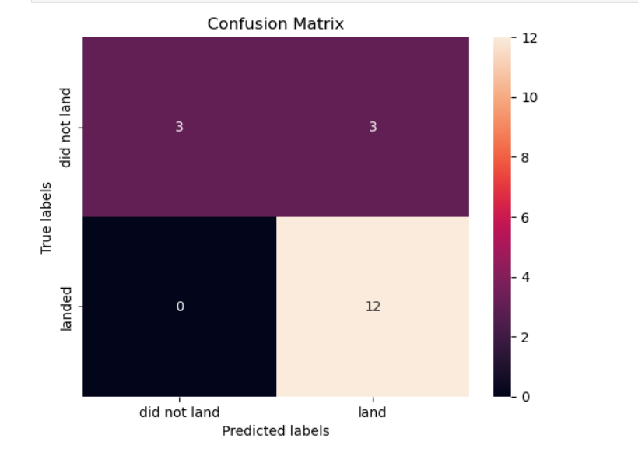
Confusion Matrix
Decision Tree Model is the highest model both all data sets and test datas.

Slide 45
Conclusions
The larger the flight amount at a launch site, the greater the success rate at a launch site.
Launching above 7000 kg is less risky.
With time Successful rates are improved.
Orbits ES-L1, GEO, HEO, SSO, and VLEO had the most success rate.
KSC LC-39A had the most successful launches of any site.
The Decision tree classifier is the best machine-learning algorithm for this task.

Slide 46
Appendix

Slide 47


